Slide 1

Selection Sort: Searching and Sorting
Data Structure | Searching and Sorting
Course: Data Structure | Chapter: Searching and Sorting | Program: Bachelor of Engineering
DISCOVER · LEARN · EMPOWER
Notes:
Welcome everyone to today's lecture on Selection Sort within our Data Structure course. We are focusing on Unit-3, specifically the Searching and Sorting chapter. Remember our motto: Discover. Learn. Empower. as we dive into this fundamental algorithm today.

Slide 2
Course Outcomes
SLIDE 2 / 14
Course Outcome
CO | BT LEVEL | DESCRIPTION
CO1 | BT1 | Understand and apply basic data structures, algorithms, complexity analysis, ADTs, arrays and linked lists.
CO2 | BT2 | Apply and implement stacks and queues in problem-solving.
CO3 | BT3 | Analyse and apply searching, sorting, and hashing techniques.
CO4 | BT4 | Construct and apply tree structures and traversal techniques.
CO5 | BT5 | Represent and solve graph problems using DFS, BFS, and graph algorithms.
Chandigarh University
2 / 14
Notes:
Today's lecture directly addresses our Course Outcomes. CO2 focuses on implementing data structures, while CO3 specifically targets the analysis and application of sorting techniques like Selection Sort. Mastering this algorithm will help you achieve both outcomes effectively.

Slide 3
Learning Objectives
SLIDE 3 / 14
Learning Outcomes
1
Define Selection Sort as a comparison-based sorting algorithm.
2
Explain the step-by-step selection and swapping mechanism.
3
Analyze the time complexity as O(n²) for all cases.
4
Demonstrate the algorithm using a numerical array example.
5
Identify common pitfalls like unnecessary swaps in sorted arrays.
Chandigarh University
3 / 14
Notes:
By the end of this session, you will be able to define Selection Sort and explain its mechanism clearly. We will analyze why it has quadratic time complexity and demonstrate it with a concrete example. Finally, we will identify common pitfalls to avoid in your implementations.

Slide 4
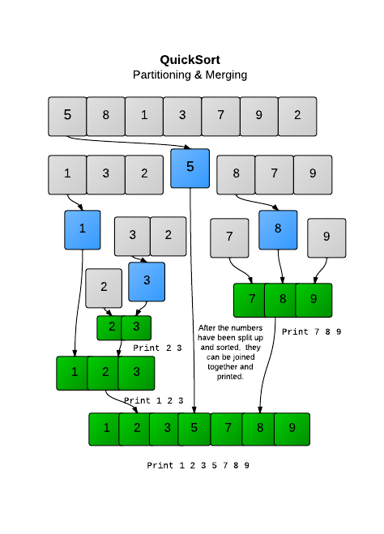
Lecture
SLIDE 4 / 14
Definition and Core Concept
1
Selection Sort divides the input list into sorted and unsorted regions.
2
The algorithm repeatedly selects the minimum element from the unsorted region.
3
It swaps the selected minimum element with the first unsorted element.
4
This process expands the sorted region by one element in each iteration.
5
The algorithm terminates when the unsorted region becomes empty.
6
It is an in-place sorting algorithm requiring constant extra memory.
Quicksort 2 - Sorting | HackerRank
Chandigarh University
4 / 14
Notes:
Selection Sort works by maintaining two subarrays: one sorted and one unsorted. In each pass, it finds the smallest element in the unsorted part and swaps it to the correct position. This simple concept makes it easy to understand but computationally expensive for large datasets.

Slide 5
Working Principle
SLIDE 5 / 14
Step-by-Step
1
Start with the first element as the current minimum candidate.
2
Scan the entire unsorted portion to find the true minimum value.
3
Compare the found minimum with the current position's element.
4
Swap them only if the minimum is smaller than the current element.
5
Move the boundary of the sorted region one step to the right.
6
Repeat until the entire array is sorted in ascending order.
Chandigarh University
5 / 14
Notes:
Let's trace the logic: we assume the first element is the minimum, then scan the rest. If we find a smaller value, we update our minimum index. Once the scan is complete, we swap the found minimum with the first element of the unsorted section. This ensures the smallest element is placed correctly.

Slide 6
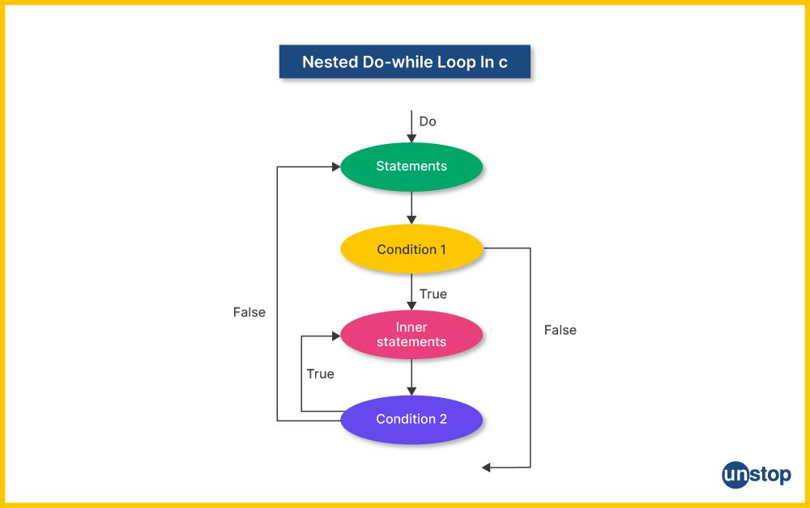
Lecture
SLIDE 6 / 14
Governing Logic and Pseudocode
GOVERNING EQUATION
Outer loop runs from index i = 0 to n-2
CONDITION
if arr[j] < arr[min_index], update min_index.
SWAP LOGIC
temp = arr[i]; arr[i] = arr[min_index]; arr[min_index] = temp.
• Inner loop runs from index j = i+1 to n-1.
• The algorithm performs exactly n-1 swaps in the worst case.
• No conditional logic is needed for the swap if min_index equals i.
Source: d8it4huxumps7.cloudfront.net
Chandigarh University
6 / 14
Notes:
The pseudocode uses a nested loop structure. The outer loop controls the position we are filling, while the inner loop searches for the minimum. We only swap if the minimum index is different from the current index to avoid unnecessary operations. This logic ensures correctness regardless of the initial array order.

Slide 7
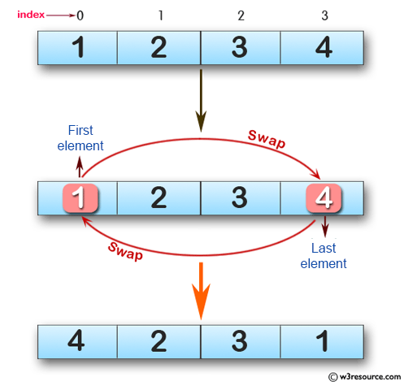
Worked Numerical Example
SLIDE 7 / 14
Pass 1
INITIAL ARRAY
[64, 25, 12, 22, 11]
ARRAY BECOMES
[11, 25, 12, 22, 64]
SORTED REGION NOW CONTAINS
[11]
UNSORTED REGION REMAINS
[25, 12, 22, 64]
• Pass 1: Find minimum in [64, 25, 12, 22, 11] which is 11.
• Swap 64 (index 0) with 11 (index 4).
Source: www.w3resource.com
Chandigarh University
7 / 14
Notes:
Let's look at our first pass. We scan the entire array [64, 25, 12, 22, 11] and find 11 is the smallest. We swap 64 and 11. Now, 11 is in its final sorted position at the beginning. The sorted region has grown to include just one element.

Slide 8
Worked Numerical Example
SLIDE 8 / 14
Pass 2
CURRENT ARRAY
[11, 25, 12, 22, 64]
ARRAY BECOMES
[11, 12, 25, 22, 64]
SORTED REGION NOW CONTAINS
[11, 12]
UNSORTED REGION REMAINS
[25, 22, 64]
• Pass 2: Find minimum in [25, 12, 22, 64] which is 12.
• Swap 25 (index 1) with 12 (index 2).
Source: static.afteracademy.com
Chandigarh University
8 / 14
Notes:
In the second pass, we ignore the first element since it's already sorted. We look at [25, 12, 22, 64] and find 12 is the minimum. We swap 25 and 12. Now the first two elements [11, 12] are sorted and in their correct positions.

Slide 9
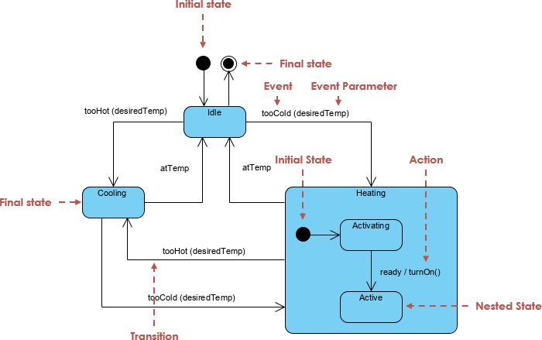
Worked Numerical Example
SLIDE 9 / 14
Final Pass
CURRENT ARRAY
[11, 12, 25, 22, 64]
ARRAY BECOMES
[11, 12, 22, 25, 64]
• Pass 3: Find minimum in [25, 22, 64] which is 22.
• Swap 25 (index 2) with 22 (index 3).
• Pass 4: Find minimum in [25, 64] which is 25.
• No swap needed as 25 is already at index 3.
Source: www.visual-paradigm.com
Chandigarh University
9 / 14
Notes:
Continuing this process, we swap 25 and 22 in the third pass. In the final pass, we check the remaining two elements. Since 25 is already smaller than 64, no swap occurs. The array is now fully sorted: [11, 12, 22, 25, 64].

Slide 10
Lecture
SLIDE 10 / 14
Time Complexity Analysis
GOVERNING EQUATION
Total comparisons = (n-1) + (n-2) + ... + 1 = n(n-1)/2
BEST CASE TIME COMPLEXITY
O(n²) comparisons.
AVERAGE CASE TIME COMPLEXITY
O(n²) comparisons.
WORST CASE TIME COMPLEXITY
O(n²) comparisons.
SWAPS ARE MINIMAL
O(n) in all cases.
• Performance does not improve even if the array is already sorted.
Chandigarh University
10 / 14
Notes:
Selection Sort always performs the same number of comparisons regardless of the input order. The number of comparisons is roughly n²/2, making it O(n²). While the number of swaps is low, the quadratic comparison cost makes it inefficient for large datasets compared to algorithms like Merge Sort.

Slide 11
Lecture
SLIDE 11 / 14
Space Complexity and Stability
SPACE COMPLEXITY
O(1) auxiliary space required.
EXAMPLE
[5a, 2, 5b] might become [2, 5b, 5a] after sorting.
• Algorithm is in-place as it modifies the original array.
• Selection Sort is an unstable sorting algorithm.
• Unstable means equal elements may change relative order after sorting.
• It is not suitable for linked lists due to random access needs.
Chandigarh University
11 / 14
Notes:
One major advantage is that it uses constant extra space, making it memory efficient. However, it is unstable, meaning the relative order of equal elements is not preserved. For instance, if you have two 5s, their original order might be swapped. This is a critical consideration for specific applications.

Slide 12
Lecture
SLIDE 12 / 14
Common Pitfalls and Errors
1
Performing a swap even when min_index equals the current index.
2
Incorrect loop bounds causing out-of-bounds array access errors.
3
Failing to update the min_index correctly during the inner scan.
4
Assuming the algorithm is fast for nearly sorted data.
5
Confusing Selection Sort with Bubble Sort regarding swap counts.
6
Using floating point comparisons without handling precision issues.
Chandigarh University
12 / 14
Notes:
A common mistake is swapping elements even when the minimum is already in the correct position, wasting CPU cycles. Another error is off-by-one errors in loop bounds, which can crash the program. Always verify your loop conditions and ensure you only swap when necessary to optimize performance.

Slide 13
Lecture
SLIDE 13 / 14
Key Takeaways
1
Selection Sort repeatedly finds the minimum element and swaps it.
2
It divides the array into sorted and unsorted subarrays.
3
Time complexity is O(n²) for all cases, making it slow for large data.
4
Space complexity is O(1), making it memory efficient and in-place.
5
The algorithm is unstable and performs poorly on nearly sorted arrays.
Chandigarh University
13 / 14
Notes:
To summarize, Selection Sort is a simple algorithm that works by repeatedly selecting the minimum element. While it is memory efficient with O(1) space, its quadratic time complexity makes it unsuitable for large datasets. Remember that it is unstable and does not benefit from pre-sorted data.

Slide 14
Lecture
SLIDE 14 / 14
References
DATA STRUCTURES
A Pseudocode Approach with C — Gilberg, Forouzan
• Data Structures — Lipschutz
• Data Structure Using C — AK Sharma
• C and Data structure — P. S. Deshpandey
Chandigarh University
14 / 14
Notes:
For further reading and detailed explanations, please refer to the textbooks listed here. Gilberg and Forouzan provide excellent pseudocode approaches, while Lipschutz offers a comprehensive theoretical foundation. Sharma and Deshpandey provide practical C implementations that complement our lecture content.

